Slide 1
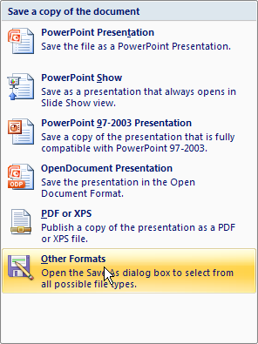
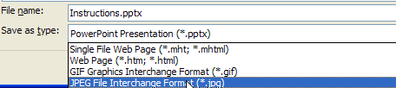
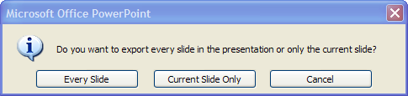
Instructions
Select a template slide
Edit the template as needed to provide the specific details of the AOP you’re describing
While viewing the slide you have edited, click Save As – Other formats (fig1)
In the save dialog box, select “JPEG File Interchange Format” (fig2)
In the next box, click “Current Slide Only” (fig3)
Fig 1
Fig 2
Fig 3

Slide 2
Level of Organization
AOP Diagram
Macro-molecular
Receptor/Ligand
Interaction
DNA Binding
Protein Oxidation
Cell/Tissue
Gene activation
Protein production
Altered signaling
Organ/Organ System
Altered physiology
Disrupted homeostasis
Altered tissue development/ function
Lethality
Impaired
Development
Impaired
Reproduction
Individual
Population
Structure
Recruitment
Extinction
Community
Community
Food-web alterations
Community
Food-web alterations
Community
Food-web alterations

